Slide 1
ENGINEERING REPORT |  | Reviewer/Team(Development) | Review Date | Approval | Issue Owner | PL | Team Leader
 |  | Reviewer Name / TV Development XXX Team | 2018.12.14 |  | Champion.Yu | James Park /Cavin Huang | Jeffrey
1.DQA MM/ Test Cause | PQ/Claim | 2.Date of Occurrence | 2018.12.14 | 3.Title(Issue Description) | DTV broken video
4. Model Name (Product Family) | K5LP ( TV ) | 5. Event | SW Verification/ SW Qualification / MP | 6. Test Item / Place of Occurrence | PQ/QA | 7.Total Occurrence | 2 100%
8.Statistical Verification | No | 9.Reason for not verifying statistics | SW issues that can pass/fail without statistical significance
[Issue Description] |  | [Causes] |  |  | [Measures]
■ Issue Description DTV broken video channel #83 on the right side of upper PIP video, or change ARC on analog channel( 4:3 , auto ) CAR motion the background video broken ■ Key Quality Characteristics : Spec : MEMC / MC off / fall back ■ Reproduction Mode/Frequency: Internal signal PS/DIL Channel #83 TV :picture mode : vivide mode Frequency : always |  | ■ 5-Why Description (Need to be described with objectivity and depth) |  |  | ■ Improvement Measures(Temporary/Fundamental Measures) Modify condition when pure video input , MC do nothing , just keep original data output.
 |  |  |  |  | ■ Improved Result - Total Occurrence after improvement : 0%(10/10 OK) check aliasing is disappear.
 |  |  |  |  | ■ Improvement Reflected Date : 2018.12.14
 |  |  |  |  | ■ Side effect Verification - N/A
 |  |  |  |  | ■ Preventive Measures When input is 50/60 and no film mode, fall back level must FULL full back.
■ Test Result(Current Level) - Occurrence Rate before Improvement: 100
 |  |  |  |  | ■ Horizontal Deployment - N/A
Why1 | * W : motion video is broken. MEMC off is OK → W1 : ME or MC problem
Why2 | * ME or MC problem, check Dehalo module. → W2 : Disable Dehalo function is better
Why3 | * This is a purev ideo input, pure video mean 50/60 input frame and no film mode → W3 : why pure video still do MEMC, for most reason, It’s keep original source is better.
Why4 | * Determine pure video flag , and disable Dehalo Module. → W4 : only disable dehalo not enough get good performance, still have some broken garbage.
Why5 | Keep real source output, use fallback to get good performance → W5 : final setting is when pure video , MC do nothing.
Root Cause | Dehalo function determine cover/uncover flag for ME module. In cover uncover region , Motion Compensation (MC) use single frame to interpolation (Pre / Cur frame) to reduce halo effect. Because this is a PIP video, if Motion Vector(MV) from Motion Estimation (ME) not stable. Dehalo module will mistake to set cover/uncover flag, so sometimes will use wrong mv data(outside black background) to interpolation, we will se the broken video.l

Slide 2
Review Result Report
Project | webOS 4.5 | Event | PV |  | Review Date | 2018.XX.XX
Review Title | Improve XXX 之類 |  |  |  | Review Item | □ Document □ Source Code
Review Document/ Source Code |  |  | Author |  | Reviewer
https://swfarmhub.lge.com:8100/#/c/40930/ |  |  | csFanChiang |  | Jerry Learnrpg Rord.tsao
Key Changes | Fixed broken video when pure video input
Expected Side Effect |  |  |  | Action
when pure video input , we still can see MEMC function work. |  |  |  | Action result per each Side Effect item N/A N/A N/A N/A N/A N/A N/A N/A N/A N/A N/A N/A
A – 1/3

Slide 3
Test Result Report
Test Item | Test Script | Expected Result | Owner | Test Result
MEMC Test | Check Internal signal of PS/DIL | No broken video | Champion.Yu | OK
A – 2/3

Slide 4
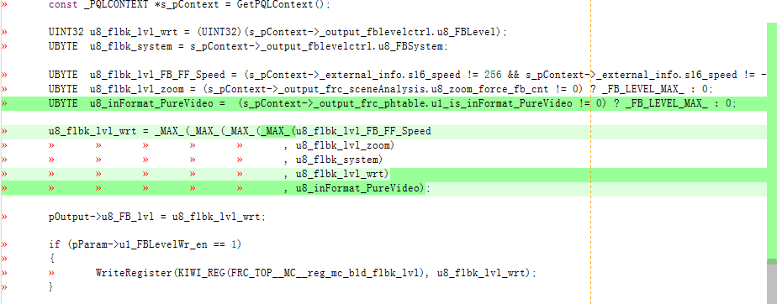
Source Code Changes
Before/After Changes Source Code diff capture
A – 3/3

